Slide 1
Ins & Outs of sp_execute_external_script - I
A drilldown into sp_execute_external_script

Slide 2
Agenda
SPEES (sp_execute_external_script)
Permissions
Parameters
@language
@script
@input_data_1
@input_data_1_name
@output_data_1_name

Slide 3
sp_execute_external_script (SPEES)
Entry point into the external engine (R, Python -- for now)
Similar to sp_executesql.
Executes the script provided as argument, at an external location.
External scripts need to be enabled
SQL Server instance needs to be restarted
Certain permissions needed

Slide 4
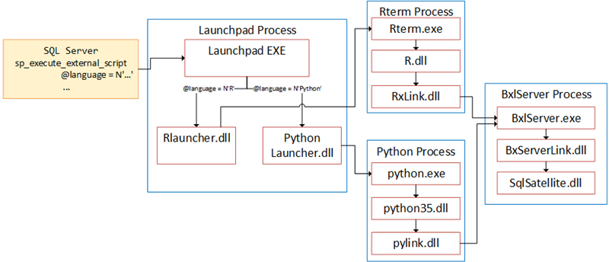
Architecture

Slide 5
Permisssions
Grant rights to user.
User needs right to execute SPEES (unless dbo).
beware SPEES is system proc - grant in master.
User needs EXECUTE EXTERNAL SCRIPT (unless dbo).
-- grant execution
USE master
GRANT EXECUTE ON sp_execute_external_script to public;
GO
-- grant rights on scripts
GRANT EXECUTE ANY EXTERNAL SCRIPT TO user1;
GO

Slide 6
SPEES Signature
sp_execute_external_script
@language = N'language',
@script = N'script',
[ @input_data_1 = 'input_data_1']
[ , @input_data_1_name = N'input_data_1_name' ]
[ , @output_data_1_name = N'output_data_1_name' ]
[ , @parallel = 0 | 1 ]
[ , @params = N'@parameter_name data_type [ OUT | OUTPUT ] [ ,...n ]' ]
[ , @parameter1 = 'value1' [ OUT | OUTPUT ] [ ,...n ] ]
[WITH <execute_option>]

Slide 7
Parameters - I
@language: Indicates what external engine to use.
@script: The script to execute. Can be literal as well as variable as well as script-file.
Read in the script from a table.

Slide 8
Parameter @script
EXEC sp_execute_external_script @language = N'R',
@script = N'iris_dataset <- iris
setosa <- iris[iris$Species == "setosa",]
meanSepWidth <- mean(setosa$Sepal.Width)
cat(paste("Seposa sepal mean width: ", meanSepWidth))';
DECLARE @scriptParam nvarchar(max) = N'iris_dataset <- iris
setosa <- iris[iris$Species == "setosa",]
meanSepWidth <- mean(setosa$Sepal.Width)
cat(paste("Seposa sepal mean width: ", meanSepWidth))';
EXEC sp_execute_external_script @language = N'R',
@script = @scriptParam;
EXEC sp_execute_external_script @language = N'R',
@script = N'source("c:/rscripts/iris_r.r")';

Slide 9
Parameters - II
@input_data_1: Statement to generate dataset to push in to the external engine.
No, there is no @input_data_2, etc.
Only one dataset can be pushed into the engine.
You can use UNION ALL / retrieve data in the script
@input_data_1_name: Name to use in script for the dataset pushed in (defaults to InputDataSet).

Slide 10
Input Data - I
EXEC sp_execute_external_script @language = N'R',
@script = N'iris_dataset <- InputDataSet
setosa <- iris_dataset[iris_dataset$Species == "setosa",]
meanSepWidth <- mean(setosa$SepalWidth)
cat(paste("Seposa sepal mean width: ", meanSepWidth))',
@input_data_1 = N'SELECT * FROM dbo.tb_irisdata_full'
EXEC sp_execute_external_script @language = N'R',
@script = N'iris_dataset <- InputDataSet
setosa <- iris_dataset[iris_dataset$Species == "setosa",]
meanSepWidth <- mean(setosa$SepalWidth)
cat(paste("Seposa sepal mean width: ", meanSepWidth))',
@input_data_1 = N'SELECT * FROM dbo.tb_irisdata_even UNION ALL
SELECT * FROM dbo.tb_irisdata_uneven';

Slide 11
Input Data - II
EXEC sp_execute_external_script @language = N'R',
@script = N'# set up connection string
sqlConnString <- "Driver=SQL Server;server=win10-dev;
database=IrisTestDb;uid=<some_uid>;pwd=<some_pwd>"
# define the data
mydata <- RxSqlServerData(table = NULL, sqlQuery = "SELECT *
FROM dbo.tb_irisdata_uneven", connectionString = sqlConnString)
# open the dataset
rxOpen(mydata)
# read the data
iris_uneven <- rxReadNext(mydata)
versicolor <- iris_uneven[iris_uneven$Species == "versicolor",]
meanSepWidthVersi <- mean(versicolor$SepalWidth)
# get the data from the input data set
iris_dataset <- InputDataSet
setosa <- iris_dataset[iris_dataset$Species == "setosa",]
meanSepWidth <- mean(setosa$SepalWidth)
# output the data
cat(paste("Seposa sepal mean width:", meanSepWidth, ".",
"Versicolor sepal mean width:", meanSepWidthVersi))',
@input_data_1 = N'SELECT * FROM dbo.tb_irisdata_even';

Slide 12
Parameters - III
@output_data_1_name: Name to use for dataset returned (default is OutputDataSet.
WITH - used to define output data set.
not a param per se, and not tied to SPEES.

Slide 13
Output Data
EXEC sp_execute_external_script
@language = N'R',
@script = N'
iris_dataset <- MyDataSet
setosa <- iris_dataset[iris_dataset$Species == "setosa",]
meanSepWidth <- mean(setosa$SepalWidth)
cat(paste("Seposa sepal mean width: ", meanSepWidth))
multiplier <- 5
iris_dataset$SepalLength <- iris_dataset$SepalLength * multiplier
SepalLengthMult <- data.frame(iris_dataset$SepalLength)',
@input_data_1 = N'SELECT * FROM dbo.tb_irisdata_full',
@input_data_1_name = N'MyDataSet',
@output_data_1_name = N'SepalLengthMult'
WITH RESULT SETS ((LengthMultiplied float));

Slide 14
Summary
sp_execute_external_script entrypoint to external engine
If not dbo, permissions required
Parameters to define language and code to execute.
Parameters to define input and output dataset.

